Slide 1


Slide 2
Event-driven architectures in practice
Lessons learned building an e-commerce platform in 6 months at cinch
Toli Apostolidis
Emily Shea (she/her)
Engineering Practice Lead
cinch
Head of Application Integration GTM
AWS

Slide 3
</>
We focus a lot on our application’s code…
Notes:
We spend a lot of time talking about code. Writing code, testing code, deploying code, monitoring code.

Slide 4

How comfortable are you throwing code out and trying something new?
Notes:
You know what may be equally important? Throwing away code.
Tossing out ideas that aren’t working in favor of better ones is a critical part of experimentation. But how comfortable are you doing it?

Slide 5
Building a new feature requires:
Spinning up infrastructure
Writing custom integration code
Coordinating with other teams on changes
Writing business logic
Notes:
Today, your held back from experimentation because each new feature is too costly to develop. You need to spin up infrastructure, write lots of code, and coordinate with other teams to make sure your changes don’t impact them.
If your goal is to deliver new product and new features as quickly as possible, experimenting as often as you can is critical. To do this, you need to reduce your team’s total cost of writing new code.

Slide 6
Today, 80% of developer time is spent in operations and maintenance.*
In the future, the only code you write will be business logic.
*Deloitte, 2019

Slide 7
Building a new feature requires:
Spinning up infrastructure
Writing custom integration code
Coordinating with other teams on changes
Writing business logic
Building serverless, event-driven architectures lets you build faster and experiment more.
Notes:
Today, your held back from experimentation because each new feature is too costly to develop. You need to spin up infrastructure, write lots of code, and coordinate with other teams to make sure your changes don’t impact them.
If your goal is to deliver new product and new features as quickly as possible, experimenting as often as you can is critical. To do this, you need to reduce your team’s total cost of writing new code.

Slide 8
What do we mean by ‘serverless’?
Automatically scale resources up and down
Native integrations built-in
Just upload your code
No server management

Slide 9





What code do you not need to write?
Amazon EventBridge
Examples:
Integrations between services to send and receive events
Services emit events automatically
Retry logic and error handling
Integrations to call AWS service APIs
AWS Step Functions
AWS Lambda
Amazon S3
Amazon DynamoDB

Slide 10
A microservice application
Order service
Payment service
Inventory service
Billing service
Search service
Delivery service
User account service
Returns service

Slide 11
A microservice application

Slide 12
A microservice application
New idea!

Slide 13
A microservice application
Coordinate changes with all these teams prior to deploying.

Slide 14
Asynchronous events reduce the need for tight coordination between teams
Event
broker

Slide 15
Asynchronous events reduce the need for tight coordination between teams
Event
broker
New service idea!

Slide 16



Serverless, event-driven architectures enable you to:
Decouple teams
Experiment constantly
Build faster

Slide 17
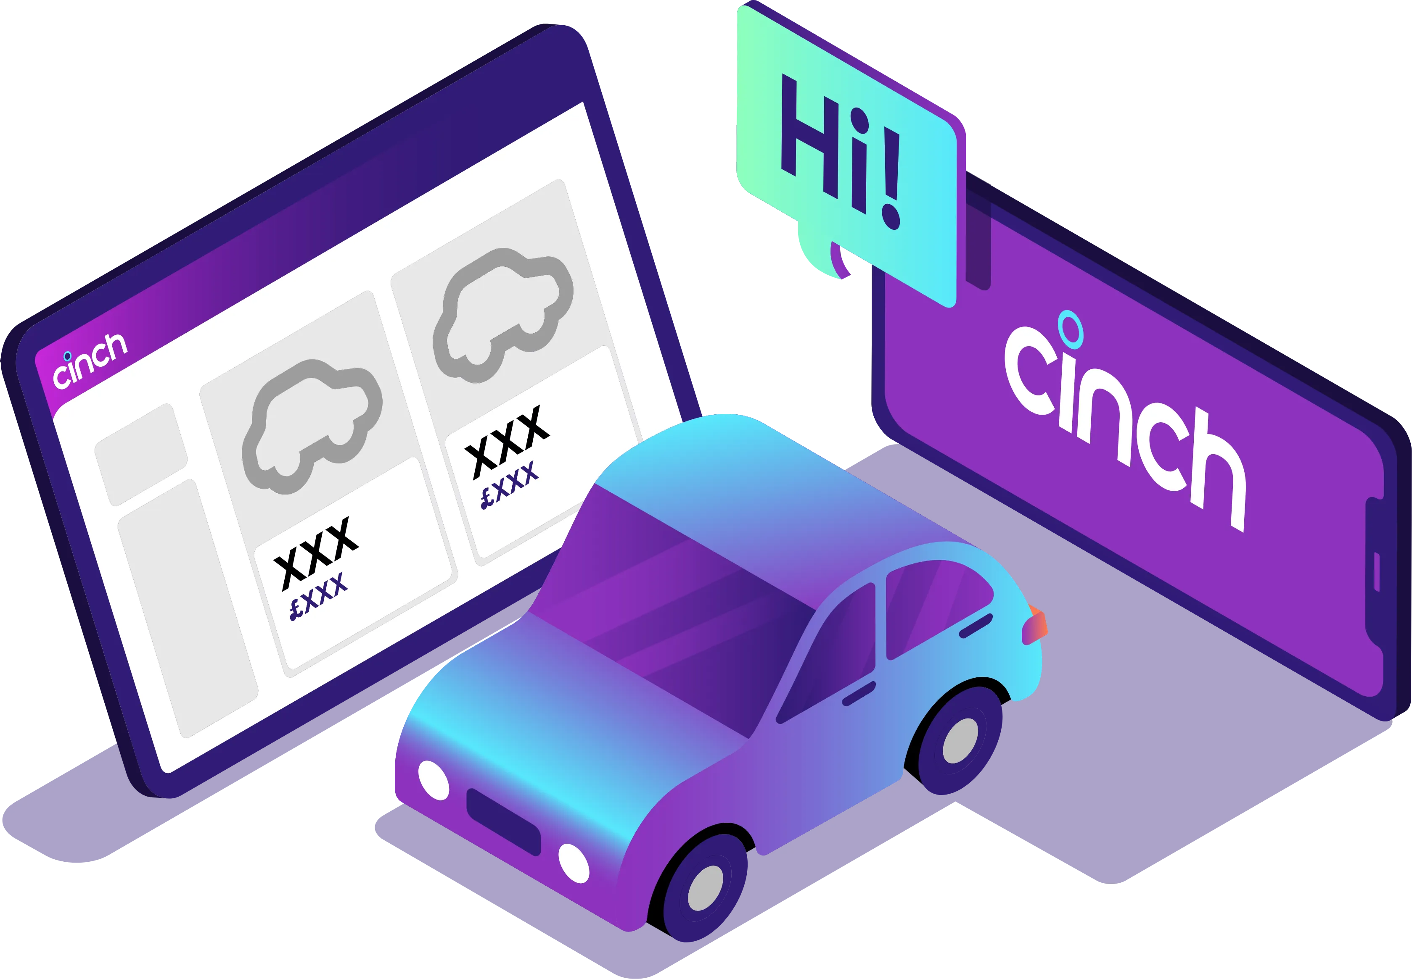

cinch: Cars without the faff
Launched Oct. 2020
Fully digital used car ecommerce site
Offers free home delivery, easy payment and financing, and guaranteed part-exchange

Slide 18
cinch launched a new business model and event-driven platform in 6 months:
Scalability: Requests exceeded 1M/minute at peak load, and request latency actually decreased as load increased.
Cost: Serverless services reduced costs by 30%.
Agility: A single squad can own the entire stack, enabling autonomous and cross-functional teams.
Growth: Achieved 10x conversion rate in just 12 months.
Notes:
Growth – With the ability to iterate fast on their product, cinch was able to drive business growth. They grew the conversion rate of customers visiting their e-commerce platform by 10x in just 12 months
By iterating on product rather than infrastructure, they improved that product so much that they increased their conversion rate by 10x

Slide 19

👋 I’m Toli.
Engineering Practice Lead at cinch
½ Geordie 🇬🇧, ½ Greek 🇬🇷
ƛ + 🏀 + 🧘
@apostolis09
10+ years building software 💻

Slide 20
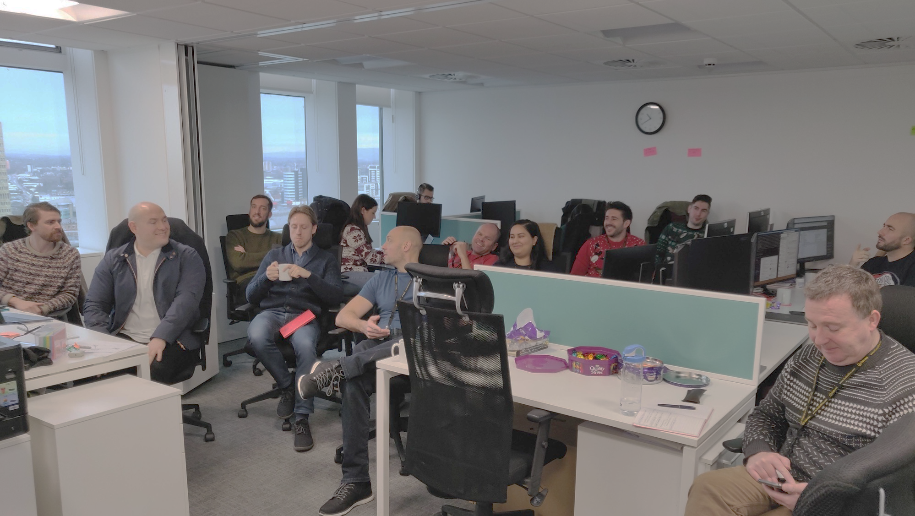
2019
Everyone at cinch
in a single room

Slide 21
2019
👉
Everyone at cinch
in a single room

Slide 22
2019
2020
April
Sept
Everyone at cinch
in a single room
Six months to deliver a
platform

Slide 23
2019
2020
2022
April
Sept
Everyone at cinch
in a single room
Six months to deliver a
platform
Evolving with existing
architecture

Slide 24
How do we disrupt an industry moving at a different pace?

Slide 25
How do we disrupt an industry moving at a different pace?
How to build and maintain momentum?

Slide 26
How to avoid building tech we don’t need?
How do we disrupt an industry moving at a different pace?
How to build and maintain momentum?

Slide 27
We chose:
✅ AWS
✅ Serverless
✅ Event Driven Architecture

Slide 28
Why serverless?

Slide 29
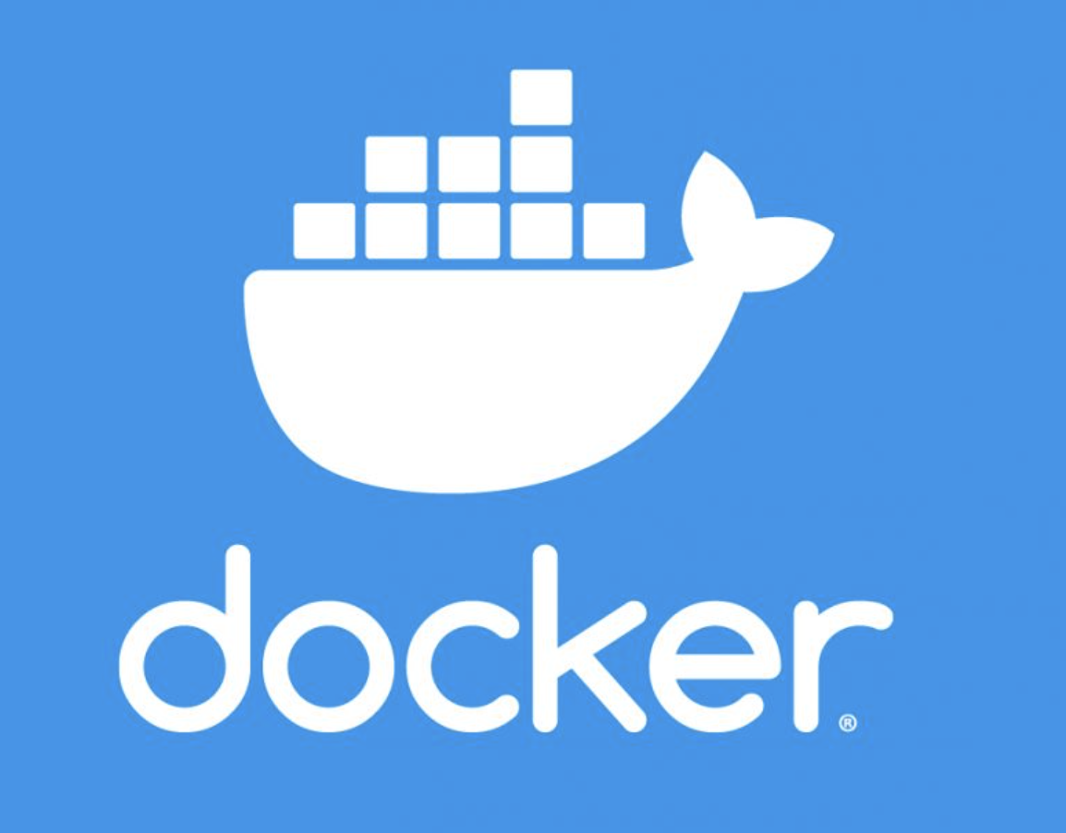

Notes:
The trend in 2019 was that k8s was hip

Slide 30
Notes:
The trend in 2019 was that k8s was hip

Slide 31
What we could care about
Usage
Maintenance
Scalability
Security
Fault tolerance
Notes:
The trend in 2019 was that k8s was hip

Slide 32


What we want to care about
👉
serverless
Usage
Maintenance
Scalability
Security
Fault tolerance
Notes:
The trend in 2019 was that k8s was hip

Slide 33
Why event driven?

Slide 34
Events
APIs
✅ Performance SLA
❌ Performance SLA
✅ Interface SLA (REST API)
✅ Interface SLA (EventBridge event)

Slide 35
How did we evolve our systems?
1
Systems, teams, tech stack
2
What patterns emerged?
3

Slide 36
How did we evolve our systems?
1
Systems, teams, tech stack
2
What patterns emerged?
3

Slide 37
Search
Finance
Order
Delivery
Post Order
Inventory

Slide 38
Search
Finance
Order
Delivery
Post Order
Inventory

Slide 39




Notes:
We later moved to CDK

Slide 40

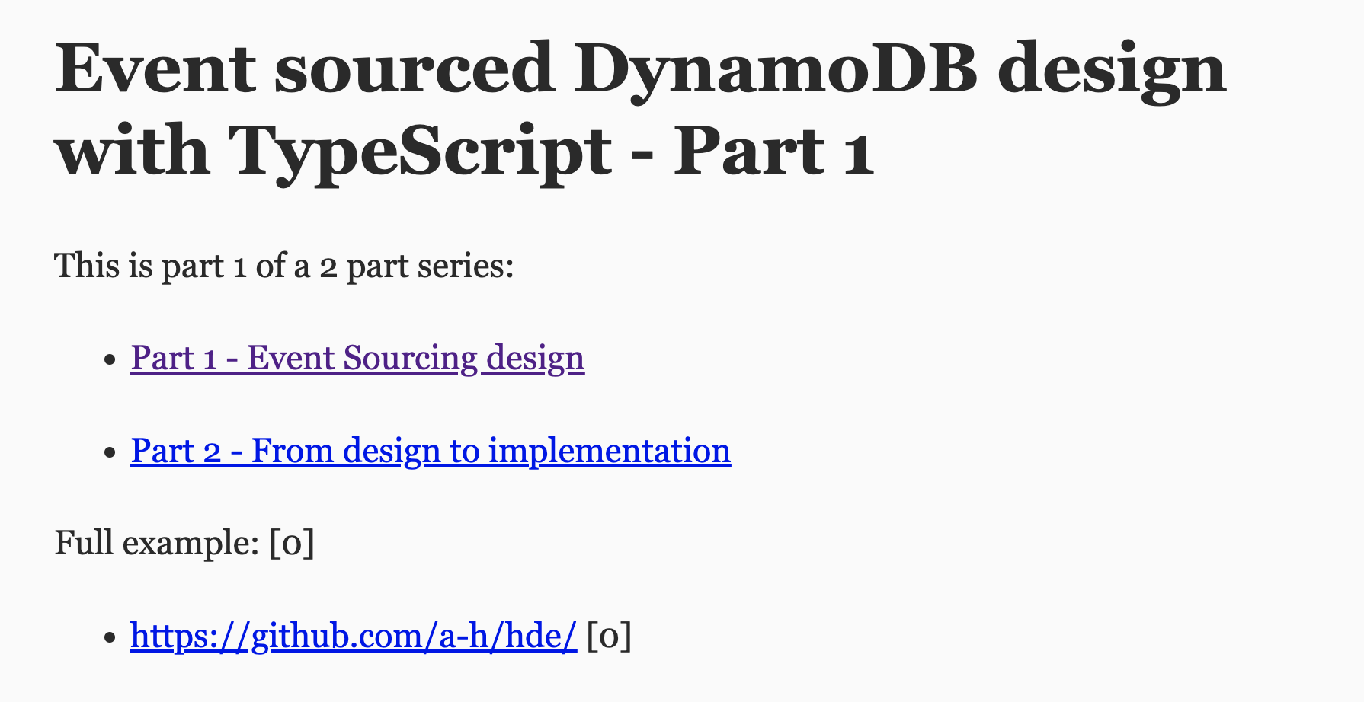
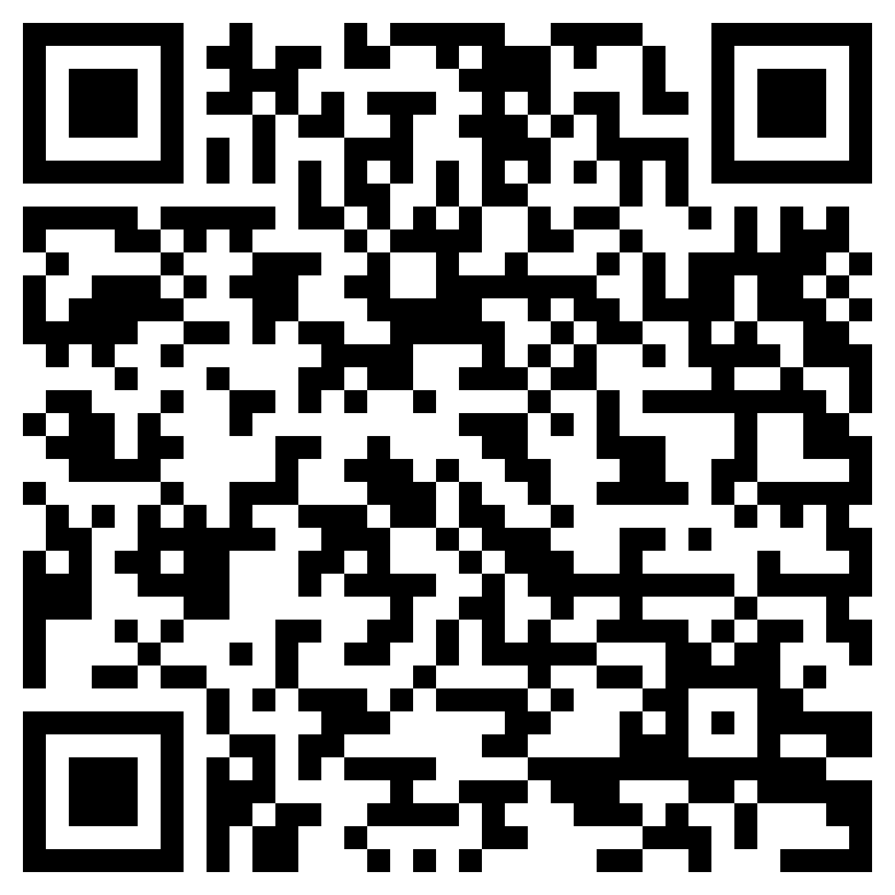
Notes:
DynamoDB for our data store
We followed. A semi event sourcing design here
If you are interested in it and how it evolved, its pros and cons, then ask AWS to ask me back next year!
https://adrianhesketh.com/2020/08/28/event-sourced-dynamodb-design-with-typescript-part-1
https://adrianhesketh.com/2020/08/28/event-sourced-dynamodb-design-with-typescript-part-2

Slide 41

💜
2019
Notes:
EB launched in 2019
We started hiring for cinch in 2019
It was a love made in heaven!

Slide 42

🪦 ✉️ 🇬🇧
Buffering data
FIFO – exactly once
Notes:
We use SQS for two purposes:
Dead letter queue
Buffering Not going to get into the detail of this though

Slide 43


What does a team own?
A “Component” at cinch
Publish Domain Event
Any trigger
Shared
Event Bus
Single Table
Notes:
Multiple single purpose Lambda handlers
Encapsulated in a bounded context, independently deployable, single-repo ‘thing’ – a ‘component’

Slide 44

What does a team own?
A “Component” at cinch
DLQ
DLQ
Publish Domain Event
Any trigger
Shared
Event Bus
Single Table
Notes:
Multiple single purpose Lambda handlers
Encapsulated in a bounded context, independently deployable, single-repo ‘thing’ – a ‘component’

Slide 45
Component publishing
Component consuming
DLQ
DLQ
DLQ
Publish Domain Event
Single Table
Shared
Event Bus

Slide 46
Component publishing
Component consuming
Component publishing
Component consuming
Shared event bus

Slide 47


Component publishing
Component consuming
Component consuming
Shared event bus
Partner events

Slide 48
How did we evolve our systems?
1
Systems, teams, tech stack
2
What patterns emerged?
3

Slide 49
Search
Finance
Order
Delivery
In Life
Inventory

Slide 50
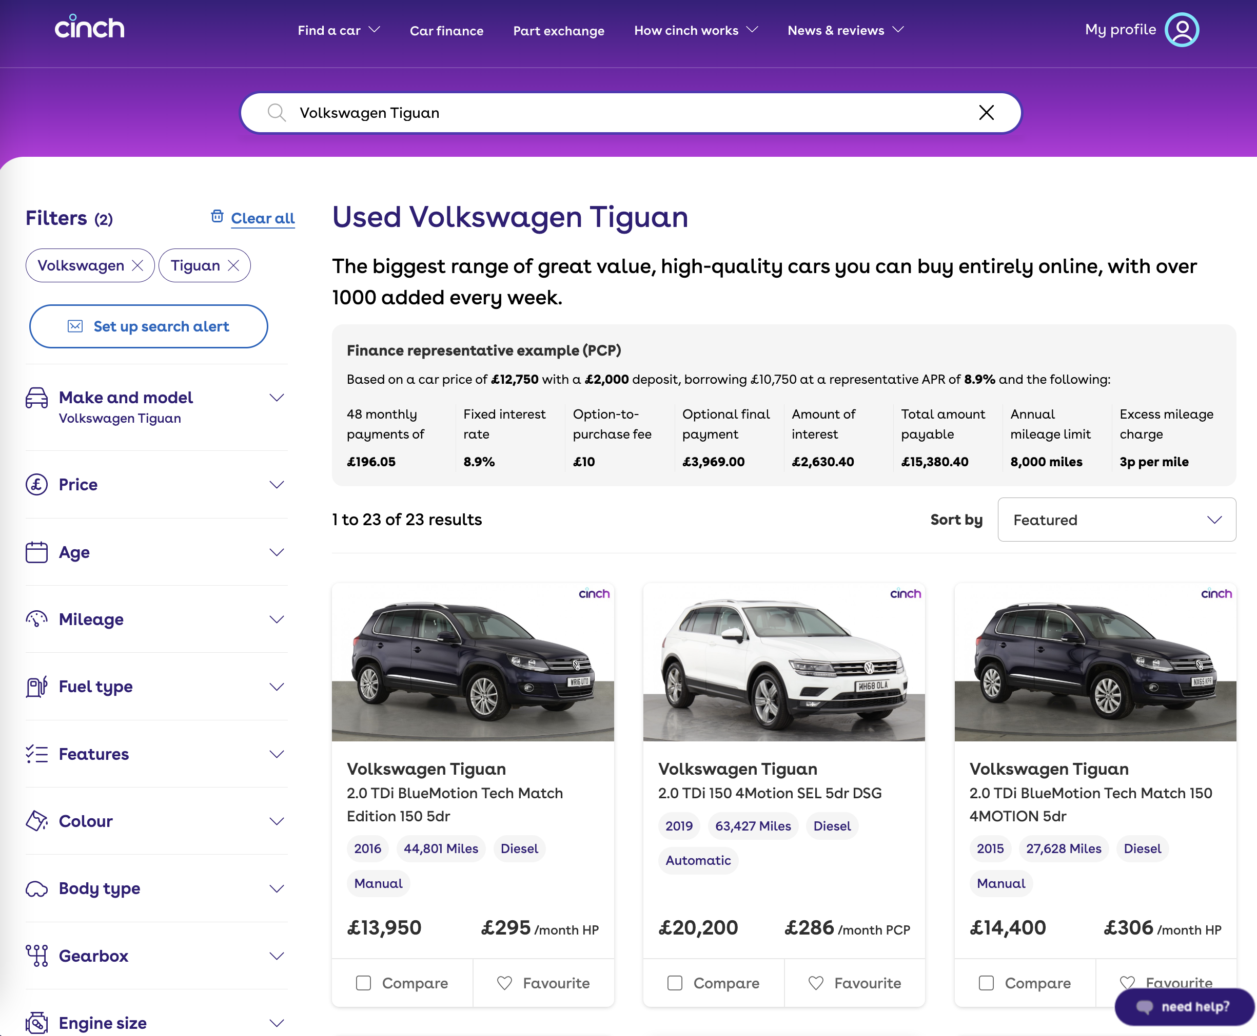
Search & filter for cars
Search

Slide 51
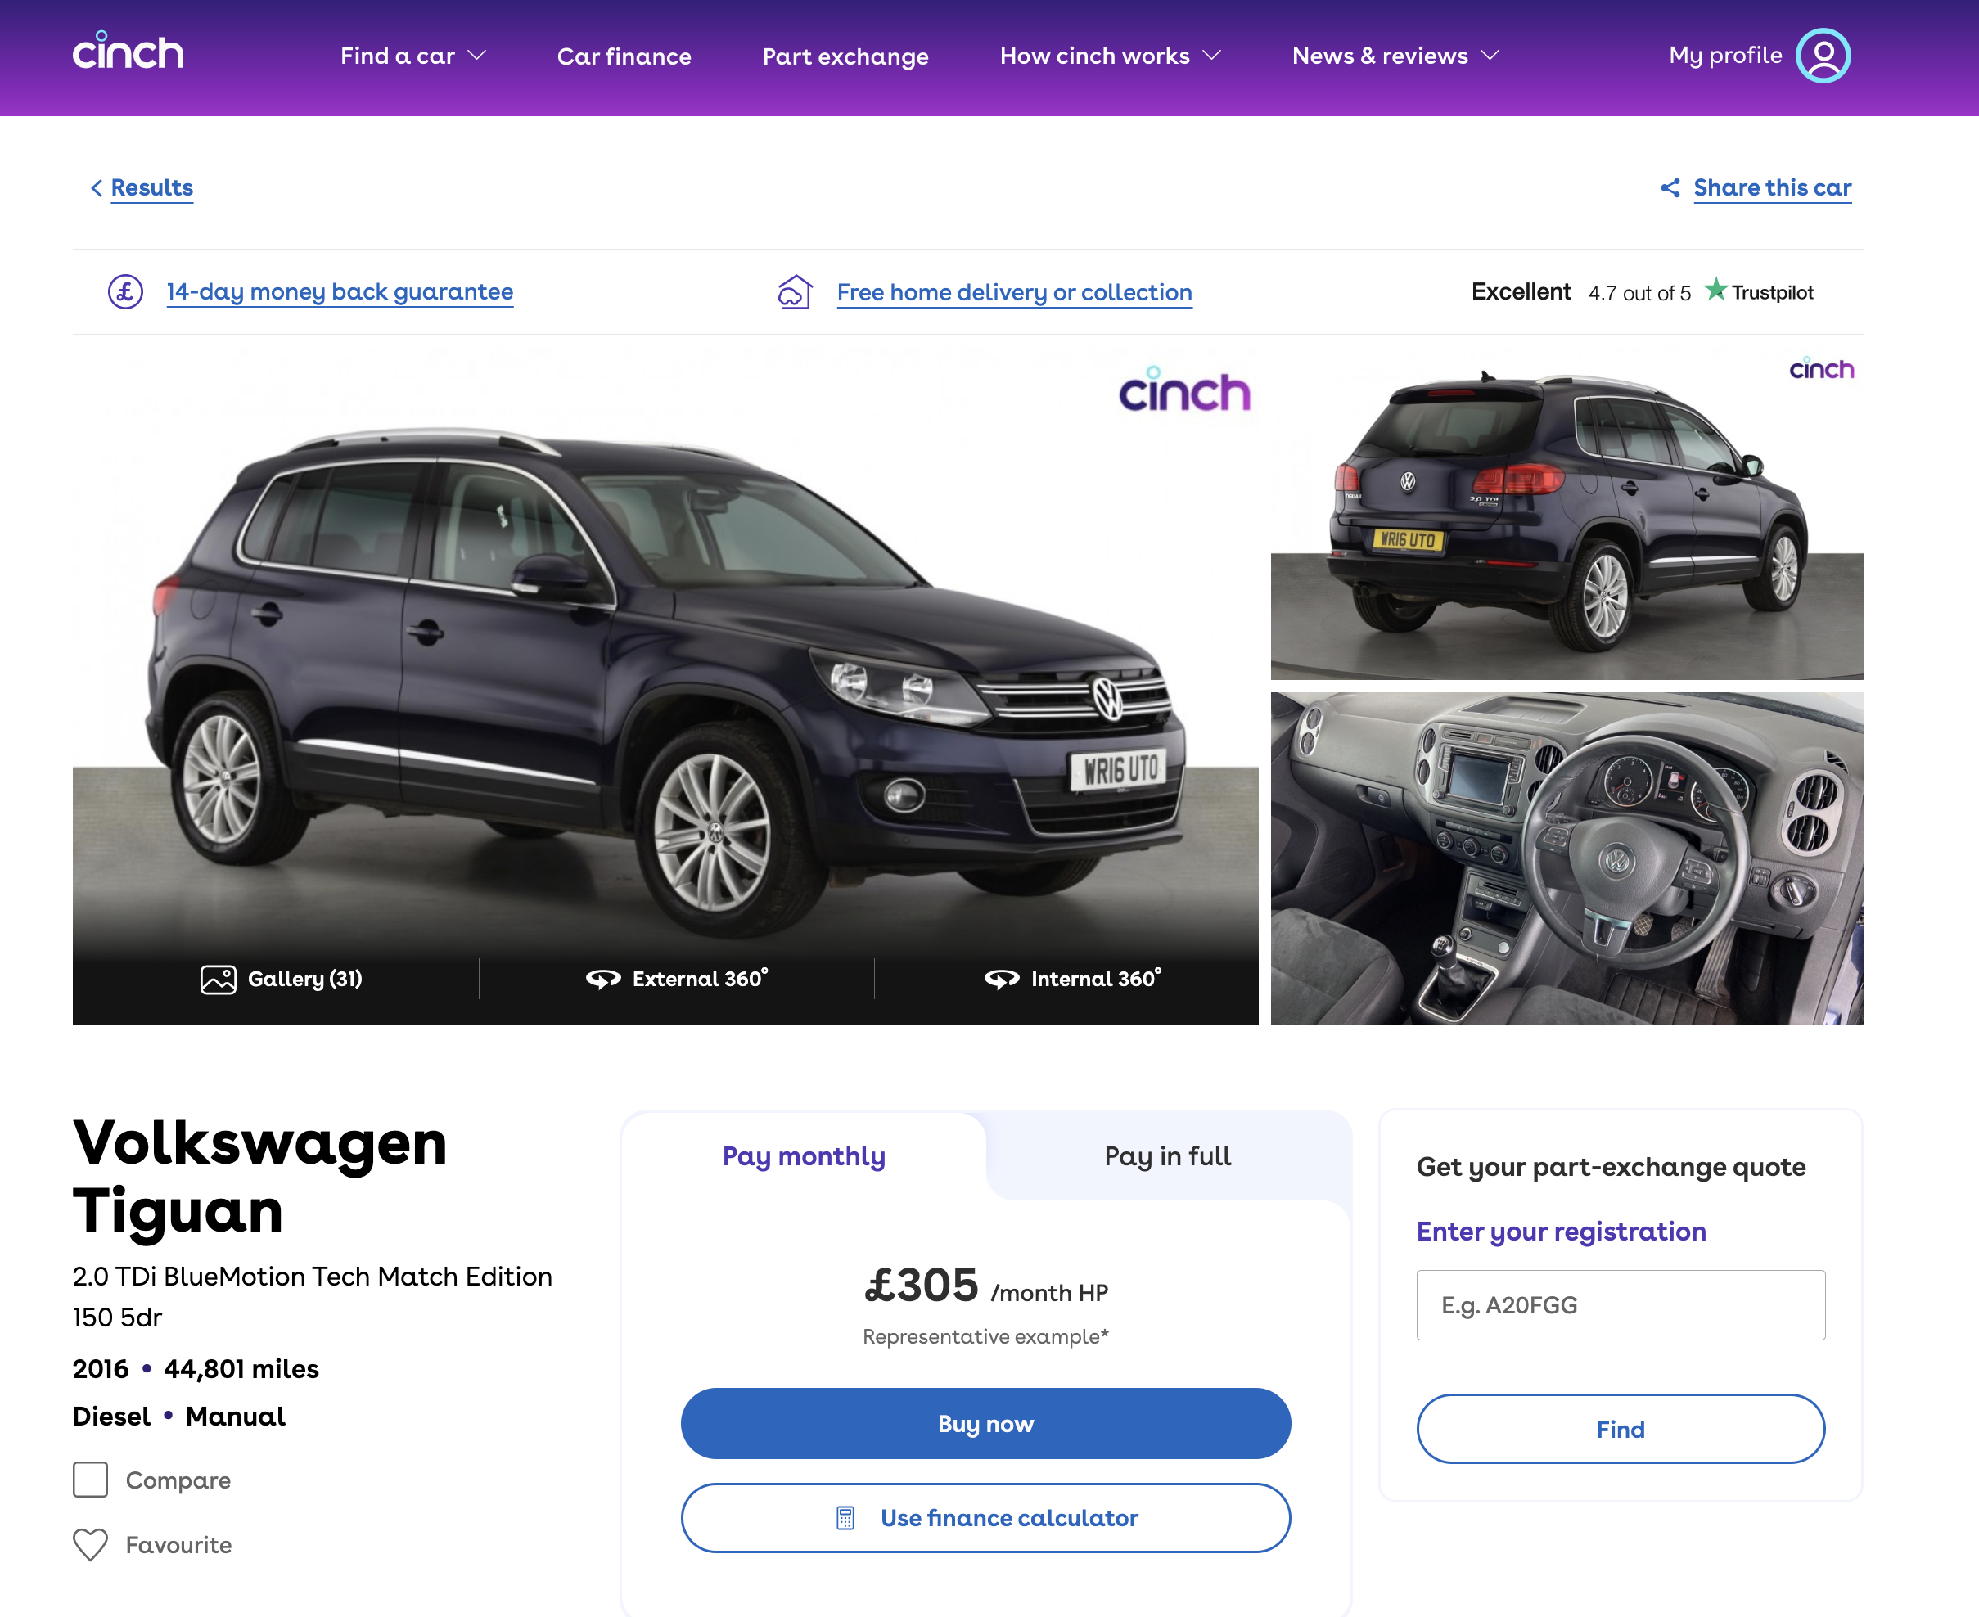
Car info & status + View car details
Inventory

Slide 52
Inventory
An aggregator of the cars’ state
External data
Inventory Component
Publish events
Internal events

Slide 53
🍽 Consumed
📣 Published
VehicleAcquired
VehicleImported
Inventory
VehicleSold
VehiclePublished
VehicleDelivered
VehicleUpdated

Slide 54
🍽 Consumed
📣 Published
VehicleAcquired
VehicleImported
Inventory
VehicleSold
VehiclePublished
👉
VehicleDelivered
VehicleUpdated

Slide 55
Search
Inventory Component
Inventory

Slide 56
How do these two systems interact*?
*in an Event Driven way

Slide 57
Shared event bus
Other Domain events
Inventory Component
Search Component
Search
Shared
event bus
3rd Party events

Slide 58
Event ledger pattern
Shared event bus
Other Domain events
Inventory Component
Search Component
Search
Shared
event bus
3rd Party events

Slide 59
Event ledger pattern
✅ Stores events
& state
Component
✅ Store & forget
3
Publish domain event
DLQ
✅ Outsource consistency
to AWS
Any trigger
1
Write domain event & state
Shared event bus
2
On state changed
✅ Publish events by default
Notes:
Event ledger is used for Playbacks, Reporting, Debugging

Slide 60
Event ledger pattern
🤔 Not CRUD, not familiar
Component
🤔 We exposed database schema
3
Publish domain event
DLQ
🤔 Mixed private and public events
Any trigger
1
Write domain event & state
Shared event bus
2
On state changed
🤔 Mixed event & state store
Notes:
Create Read Update Delete

Slide 61
🤔 How are we solving this?

Slide 62
Event/State Store pattern
✅ Event store helps with debugging
Component
DLQ
3
Publish domain events
✅ Consistent & stateless flow of data
✅ State store as cache
Any trigger
1
Write event to Event Store
Shared event bus
2
Write state to State Store
✅ State store serves as a presentation layer

Slide 63
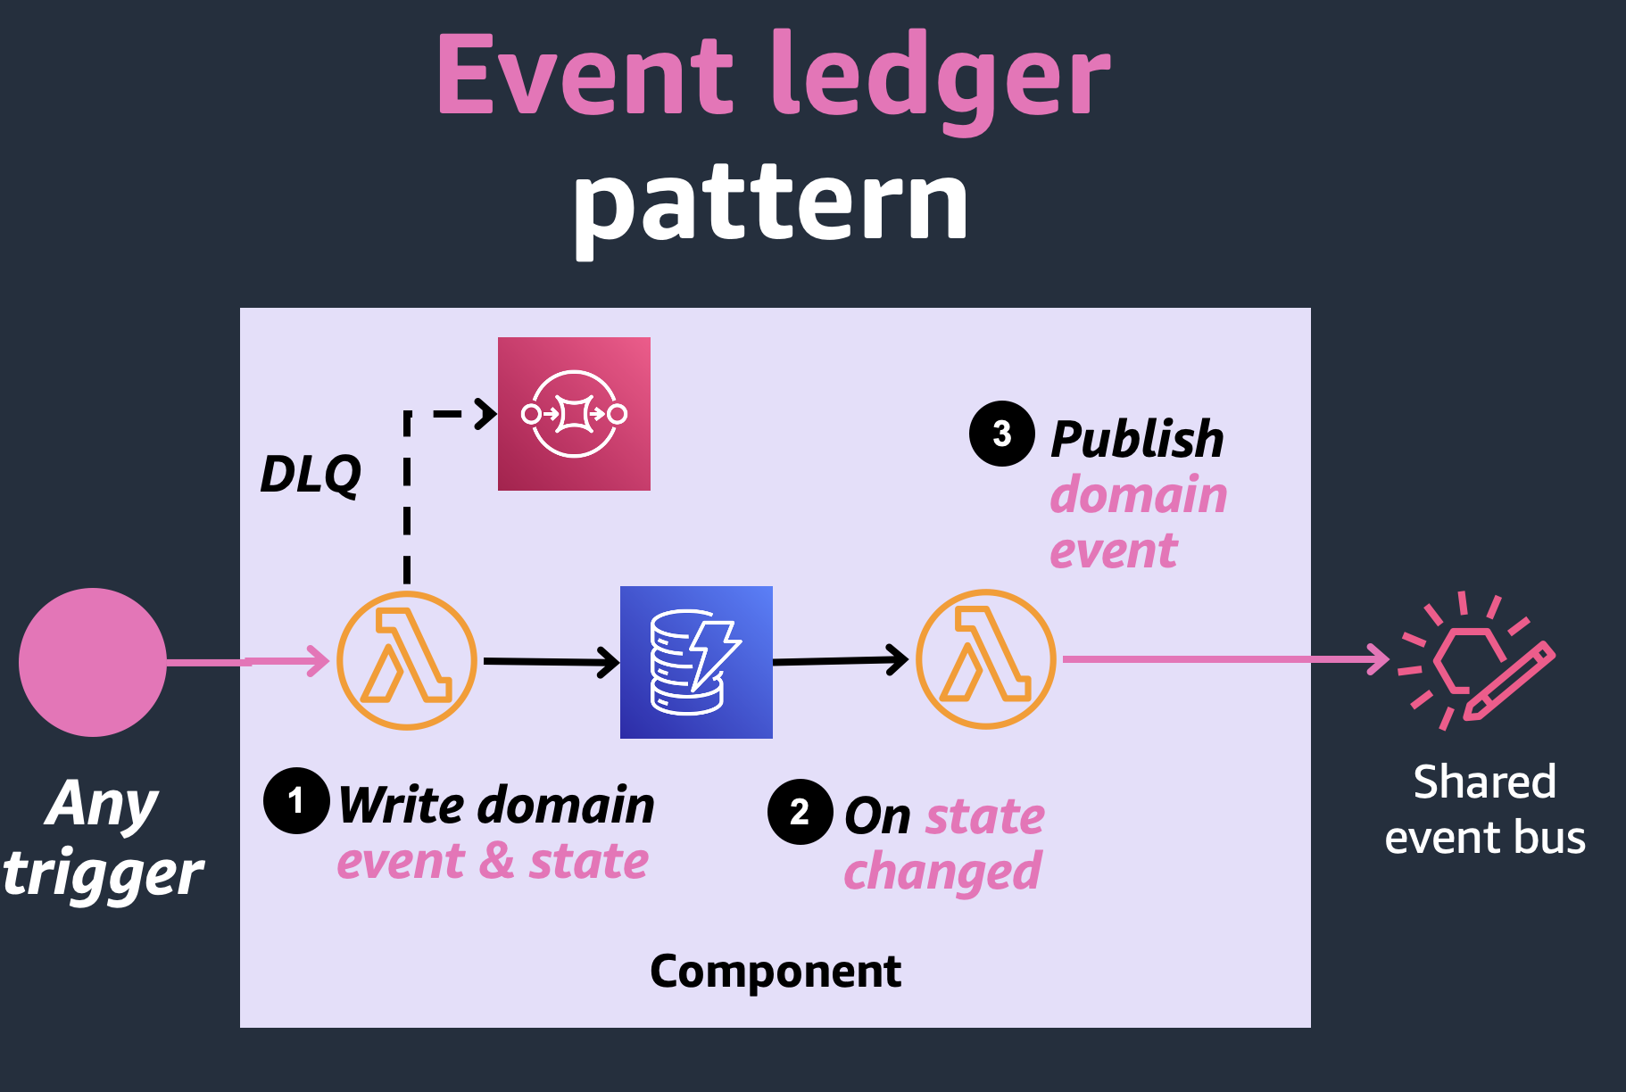
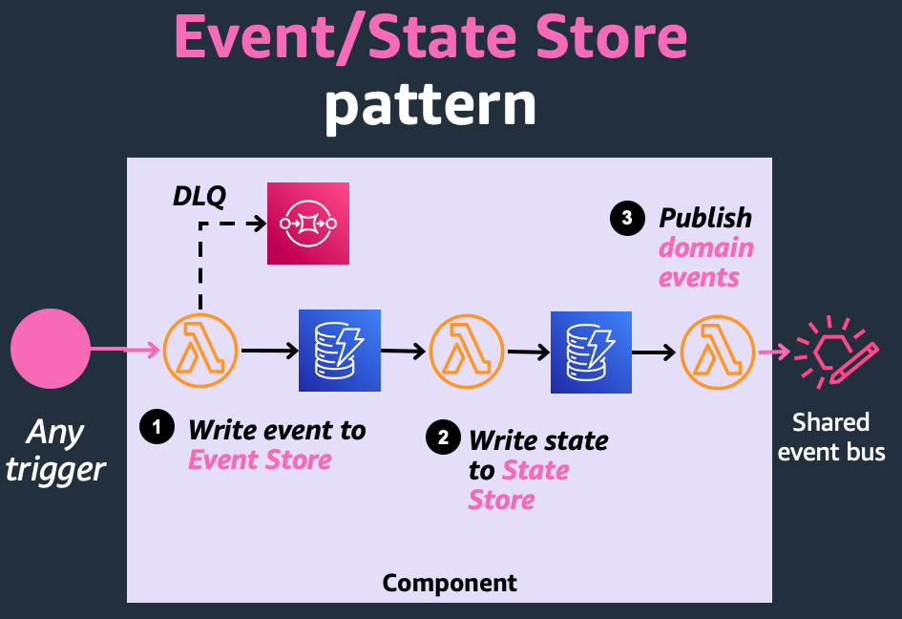

Slide 64
How to share vehicle updates*?
*In an Event Driven way

Slide 65
Shared event bus
The God event pattern
Other Domain events
Inventory Component
Search Component
Search
Shared event bus
3rd Party events

Slide 66
The God event pattern
👉
Domain Events
Internal Components
Inventory Component
Internal Components
Internal Components
Vehicle Updated
Shared event bus
3rd Parties
Shared
3rd Party Data Events

Slide 67
has all the state about a vehicle
a “latest state” event
a general-purpose update event
VehicleUpdated
has 80+ fields
the contract never breaks

Slide 68
has all the state about a vehicle
Event Carried State Transfer
a “latest state” event
👉
a general-purpose update event
VehicleUpdated
has 80+ fields
the contract never breaks

Slide 69
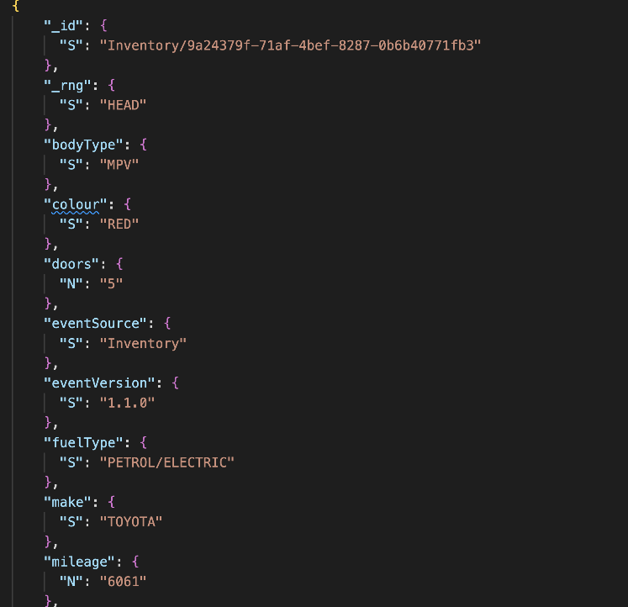
Information about the car
👉
👉

Slide 70
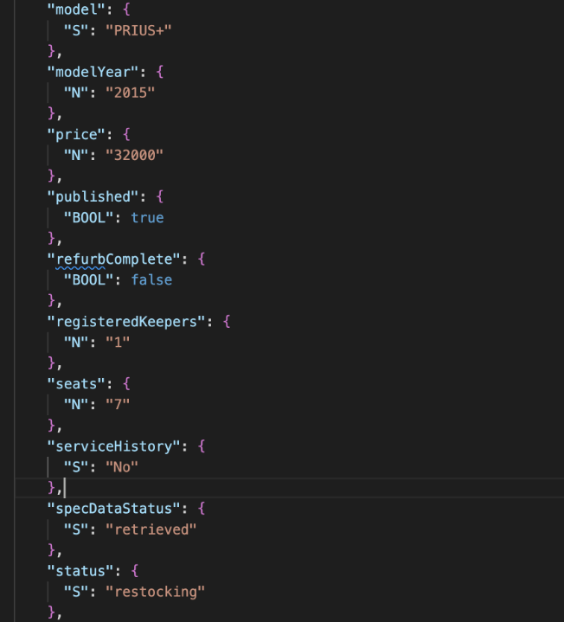
Information about the car
Information about the car status

Slide 71
Metadata about the event
👉

Slide 72
Some implementation detail
👉

Slide 73
The God event pattern
Inventory Component
VehicleUpdated
VehicleUpdated
Search Component
Shared event bus

Slide 74
The God event pattern
Search Component
Inventory Component
Orders Component
VehicleUpdated
VehicleUpdated
Delivery Component
Shared event bus
Finance Component

Slide 75
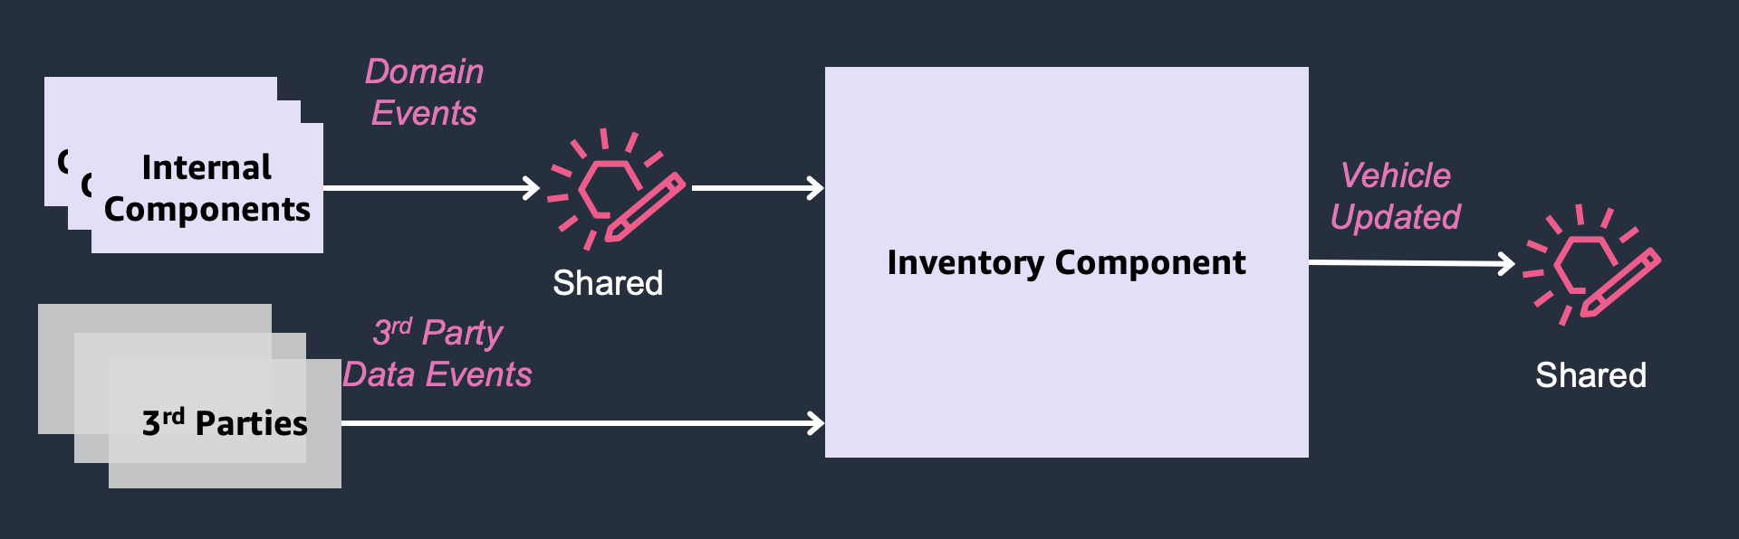
The God event pattern
Builds a rich view of a vehicle from diverse events
Publishes “all the things” vehicle in a single event
Indirectly defines many states and reports

Slide 76
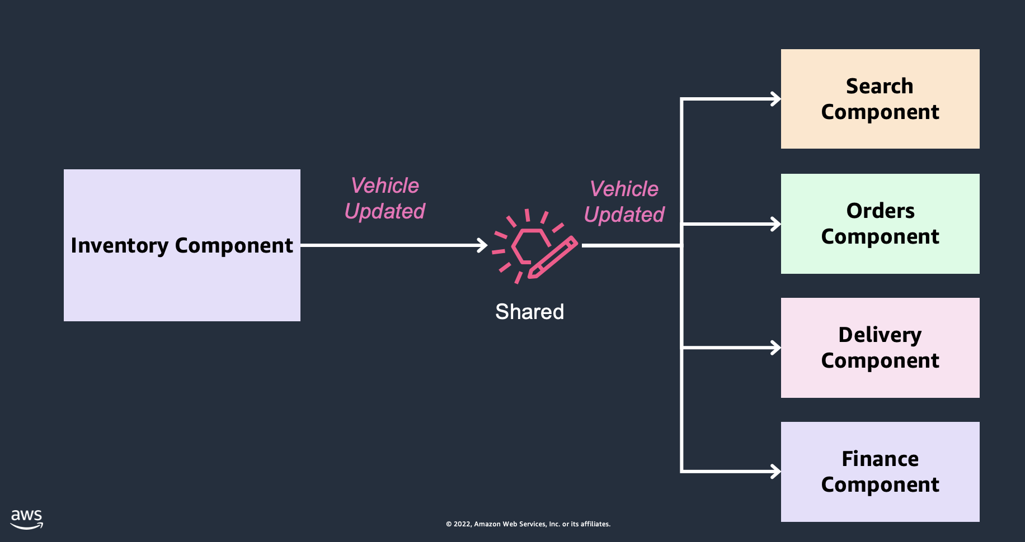
The God event pattern
✅ You can trust you will find all the data you need
✅ No need to hit an API to get extra information
✅ The only integration point between systems
✅ We were scaling a unicorn, it was fast
Notes:
EDA but coupled and not micro service

Slide 77
The God event pattern
🤔 Component & team are accidental proxies of info
🤔 Component coupled with many components for many reasons
🤔 Change is hard
🤔 When used by reporting systems, you are stuck

Slide 78
🤔 How are we solving this?

Slide 79
Break down the God Event & the mega-components
3
Backwards compatible with God event
2
Inventory Component
Search Component
Vehicle Updated
Vehicle Updated
Orders Component
Pricing Component
VehiclePriceIncreased
Shared
event bus
1
More specific & contextual events
Delivery Component
Valuation Component
VehicleValuationDecreased
Finance Component

Slide 80
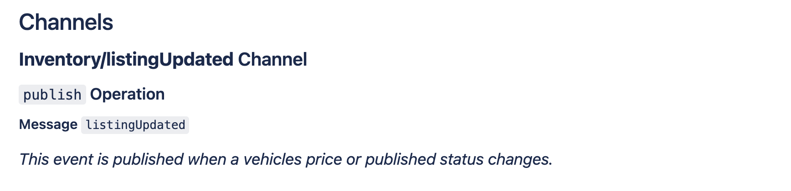
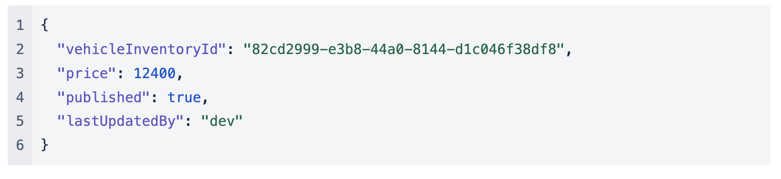
More cohesive context
More specific event name

Slide 81
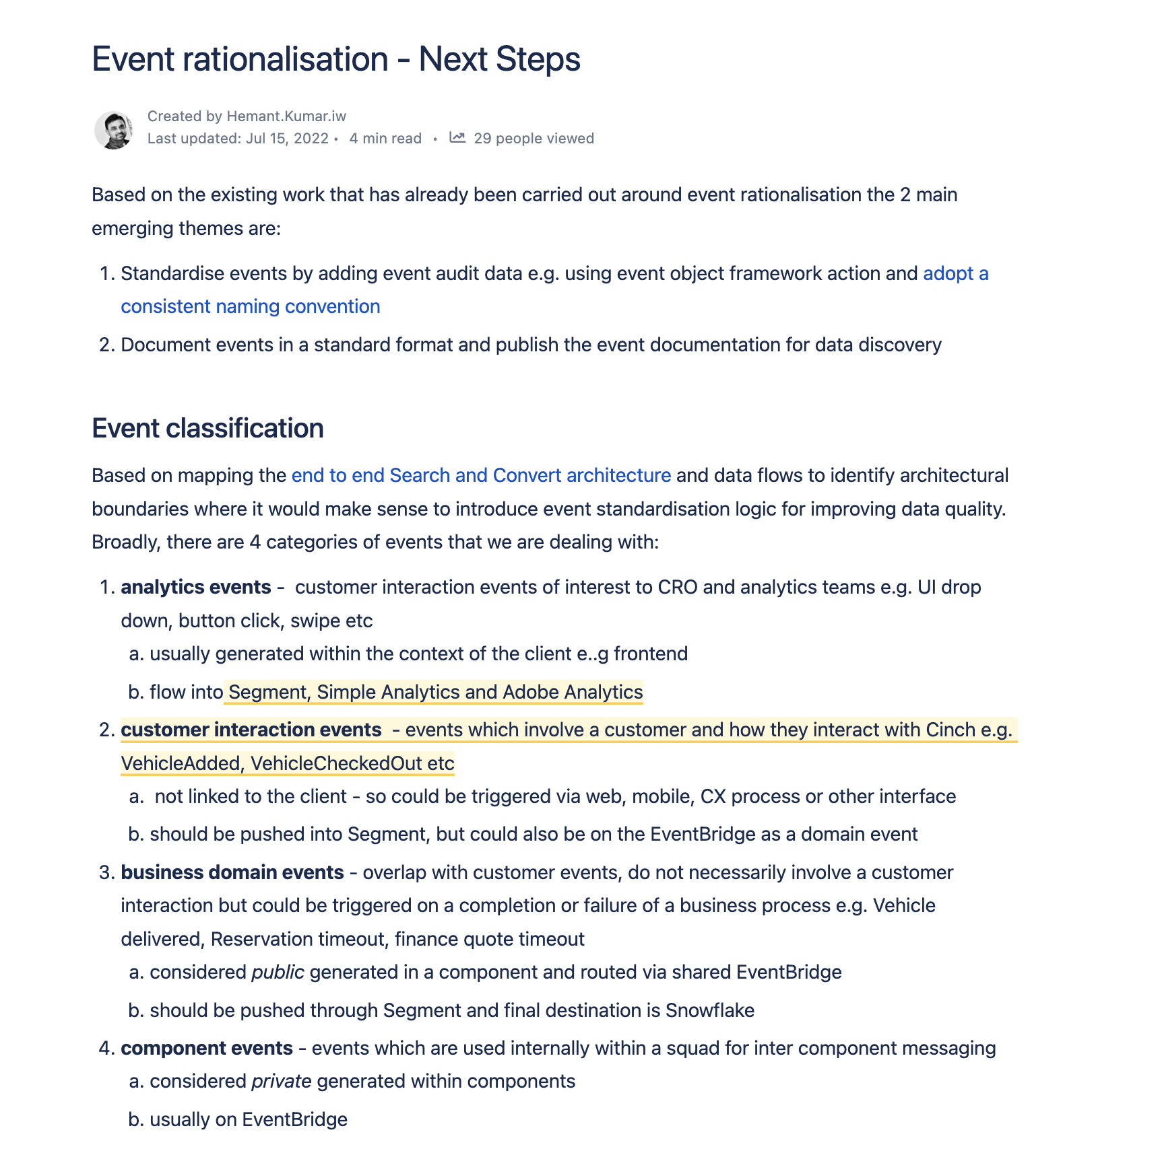
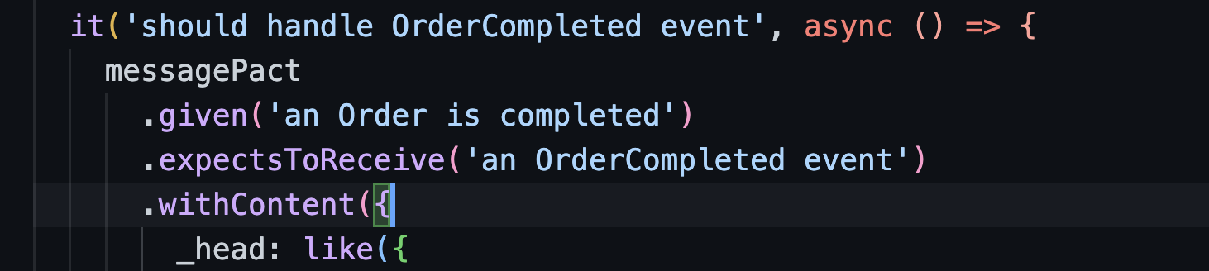
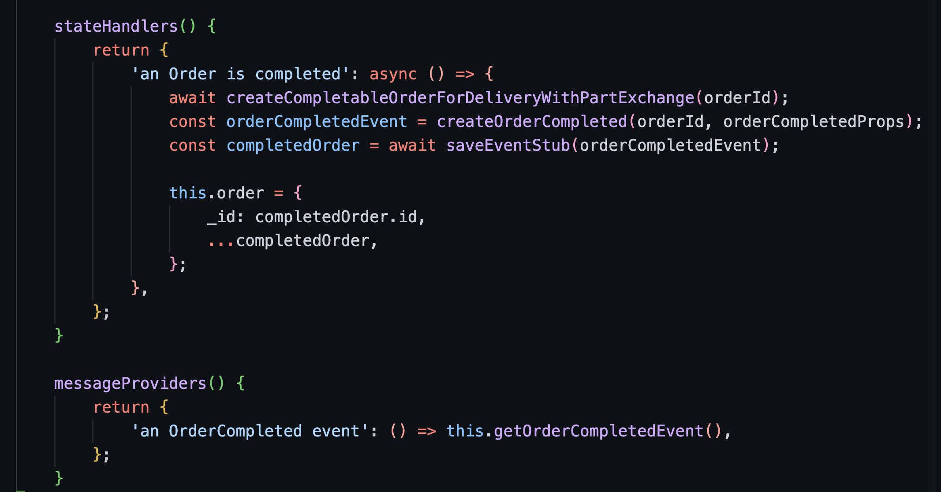
Contract testing between components
Event rationalization

Slide 82
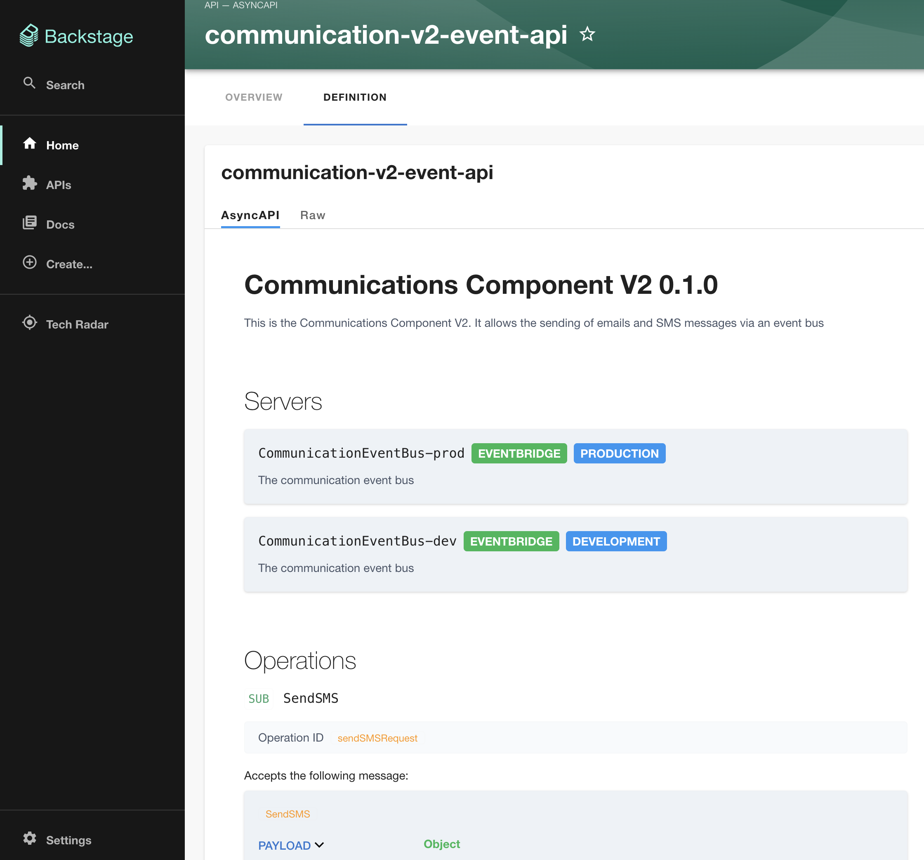
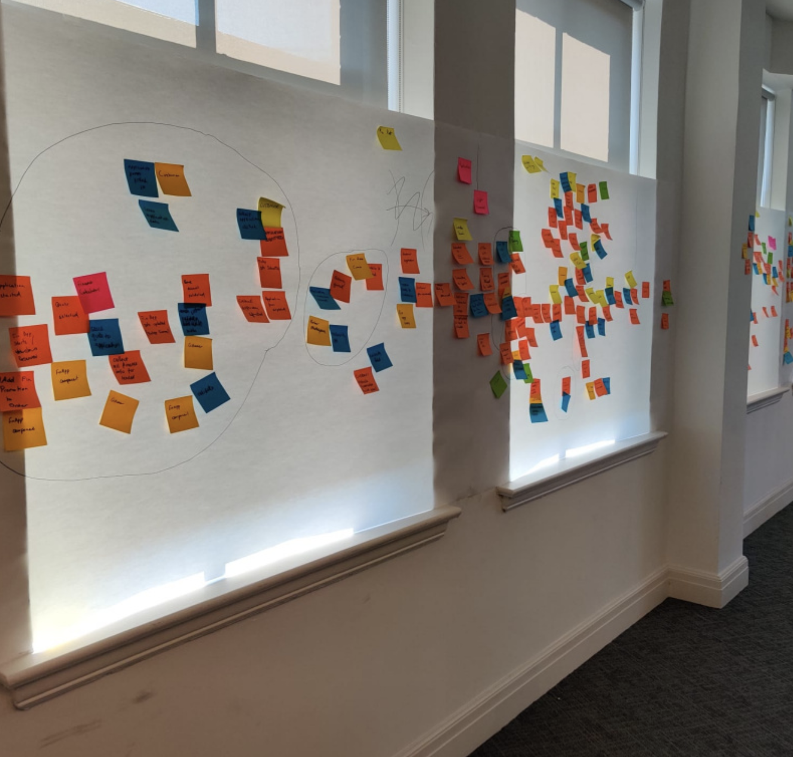
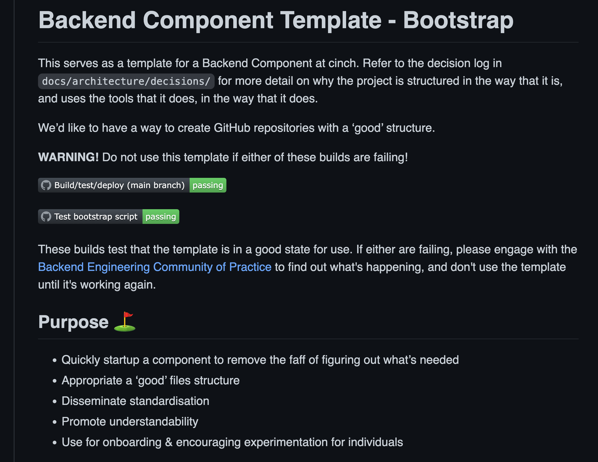
Domain Driven Design Practices
cinch
Backend Template as Blueprint
Event discoverability

Slide 83
Shared event bus
The God event pattern
Other Domain events
Inventory Component
Search Component
Search
Shared event bus
3rd Party events

Slide 84
Shared event bus
Consuming the
God event
Other Domain events
Inventory Component
Search Component
Search
Shared event bus
3rd Party events

Slide 85

Search
Inventory
Notes:
Initially there was a lot of chatter

Slide 86
Search
Search Component
2
Write state
Shared event bus
1
Validate & parse events from multiple sources
3
Shallow copy of vehicle state

Slide 87


Search
Search Component
2
Get latest vehicles
Every minute
3
Load vehicle snapshot
4
Store snapshot
1

Slide 88

Search
Search Component
3
Sort & Filter
cars
API Gateway /vehicles
2
Fetch
snapshot
1
User searches cars

Slide 89
How did we evolve our systems?
1
Systems, teams, tech stack
2
What patterns emerged?
3

Slide 90
🤔 How to extend this system?

Slide 91
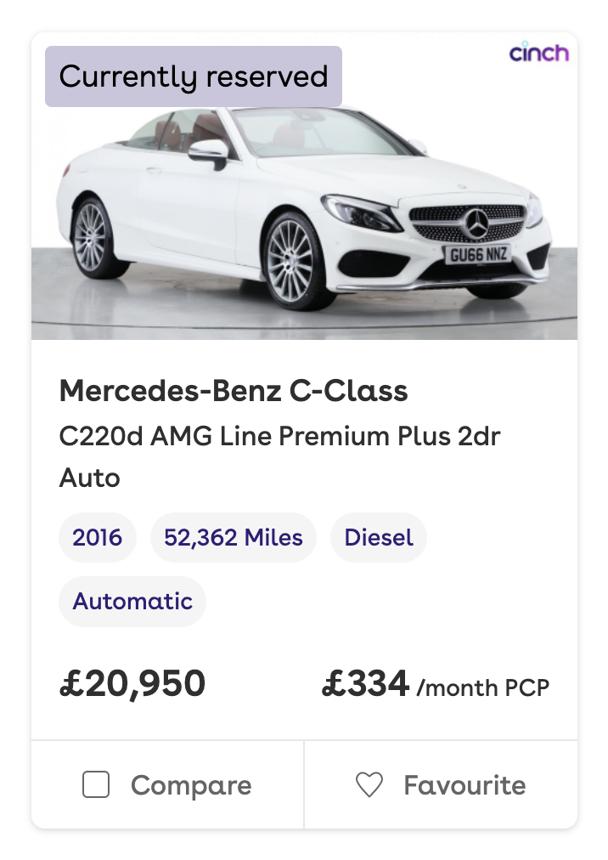
Marking a car as reserved
👉

Slide 92
👉
4
Surface cars in search
1
Publish VehicleUpdated
2
Consume VehicleUpdated
Inventory Component
Search Component
Shared event bus
3
Build vehicle snapshot

Slide 93
👉
4
Surface cars in search with vehicle reserved status
Inventory Component
Search Component
Orders Component
Shared event bus
1
Publish VehicleReserved
2
Consume VehicleReserved
3
Build vehicle snapshot + vehicle reserved status

Slide 94
Marked a car as reserved
✅

Slide 95
🤔 How to evolve this system?

Slide 96
Search & filter for cars
Inventory of cars + Full Page Ad for cars
Search
Inventory

Slide 97
✅ Publishes vehicle state for anyone who might care
Inventory
Search
Shared event bus
❌ Ends up considering presentation layer

Slide 98
❌ Has to consume loads of events
✅ Has control of its own data
Inventory
Search
Shared event bus

Slide 99
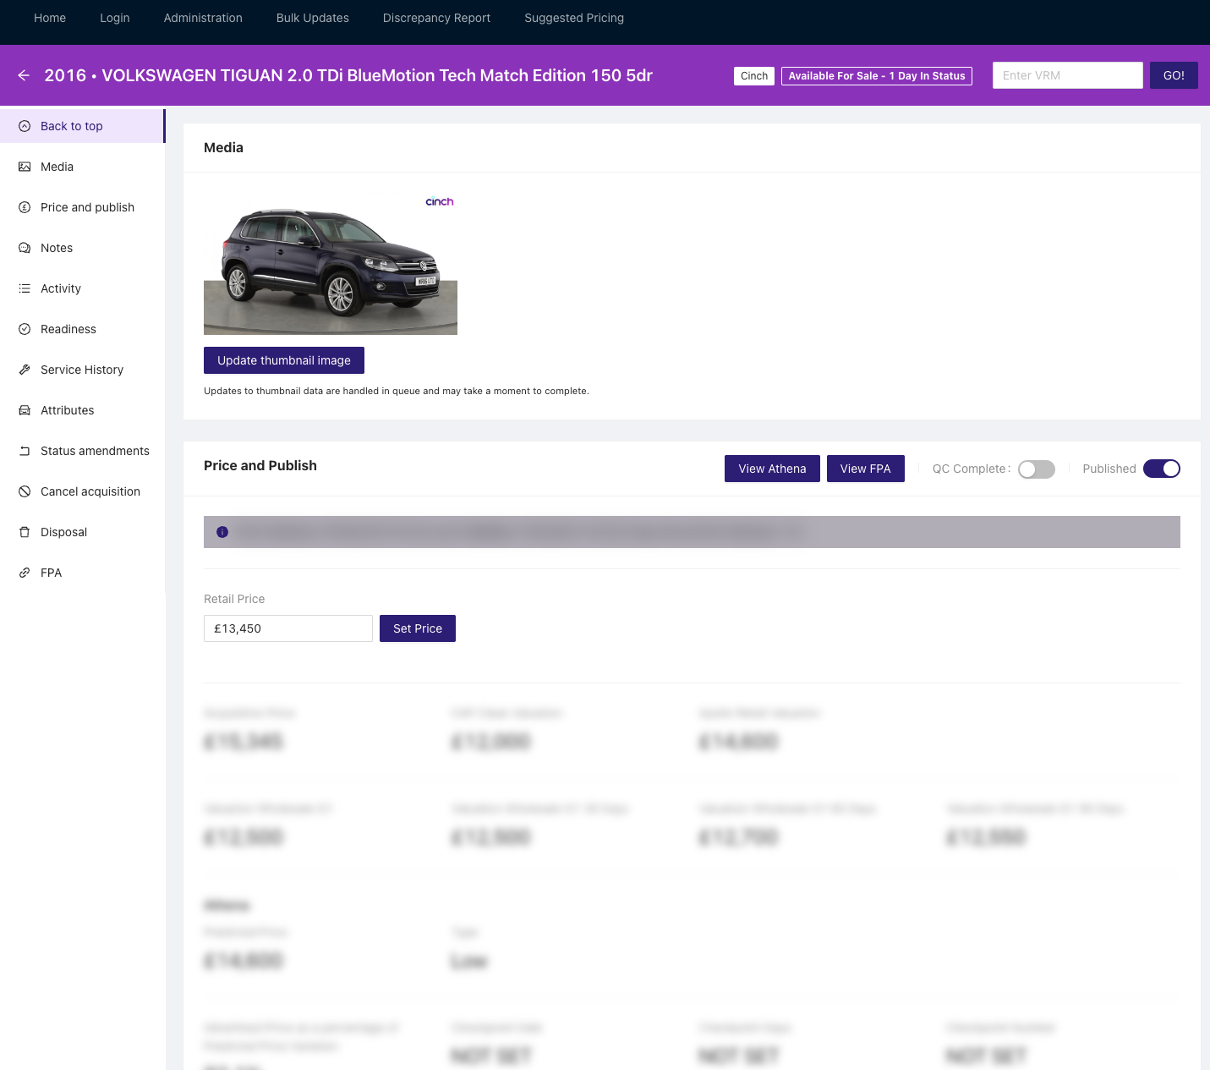
Search & filter for cars
Full Page Ad
for cars
Inventory
of cars
Search
Vehicle Detail
Inventory

Slide 100
Inventory/ VehicleUpdated
VehicleDetail/
VehicleStateUpdated

Slide 101
Inventory/ VehicleUpdated
VehicleDetail/
VehicleStateUpdated
3
Publish VehicleStateUpdated
1
Publish VehicleUpdated
Inventory
Vehicle Detail
Search
Shared event bus
Shared event bus
4
Consume VehicleStateUpdated
2
Consume VehicleUpdated

Slide 102
Event/State Store pattern
Inventory Component
Vehicle Detail Component
👉
3
Publish VehicleStateUpdated
1
Write events to Event Store
2
Write state to State Store
Shared event bus
Orders Component

Slide 103
Lazy consumer pattern
Consumes
single
event
Vehicle Detail
Search
VehicleStateUpdated
Shared event bus
Publishes
multiple events
👉

Slide 104
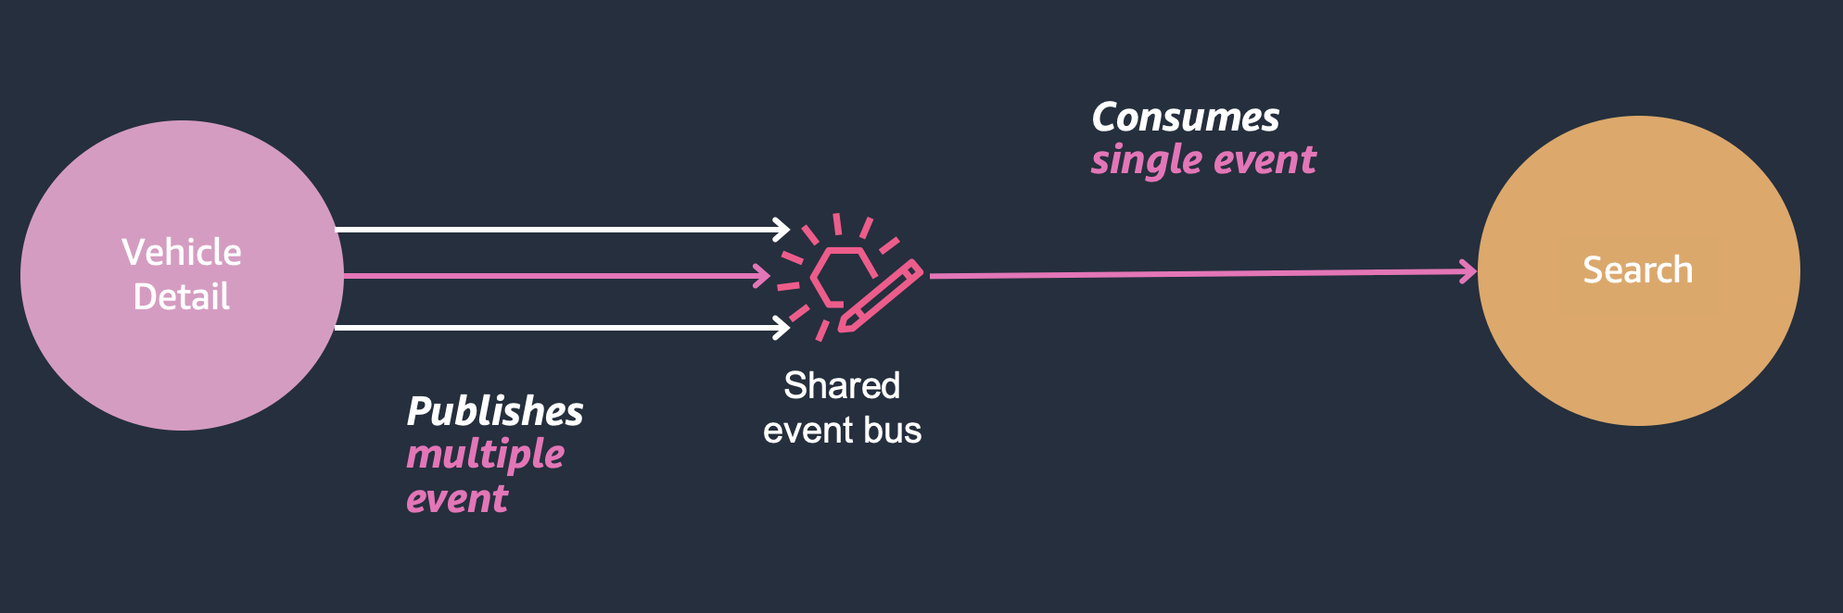
Lazy consumer pattern
✅ Only cares about one event
✅ Only speaks to one team
✅ Coupled with more suitable system
✅ Focuses on what makes them awesome

Slide 105
Lazy consumer pattern
🤔 Does not control its destiny
🤔 Relies on documentation
🤔 Has to translate data again
🤔 What if the event stops getting published?

Slide 106
🤔 How are we solving this?

Slide 107
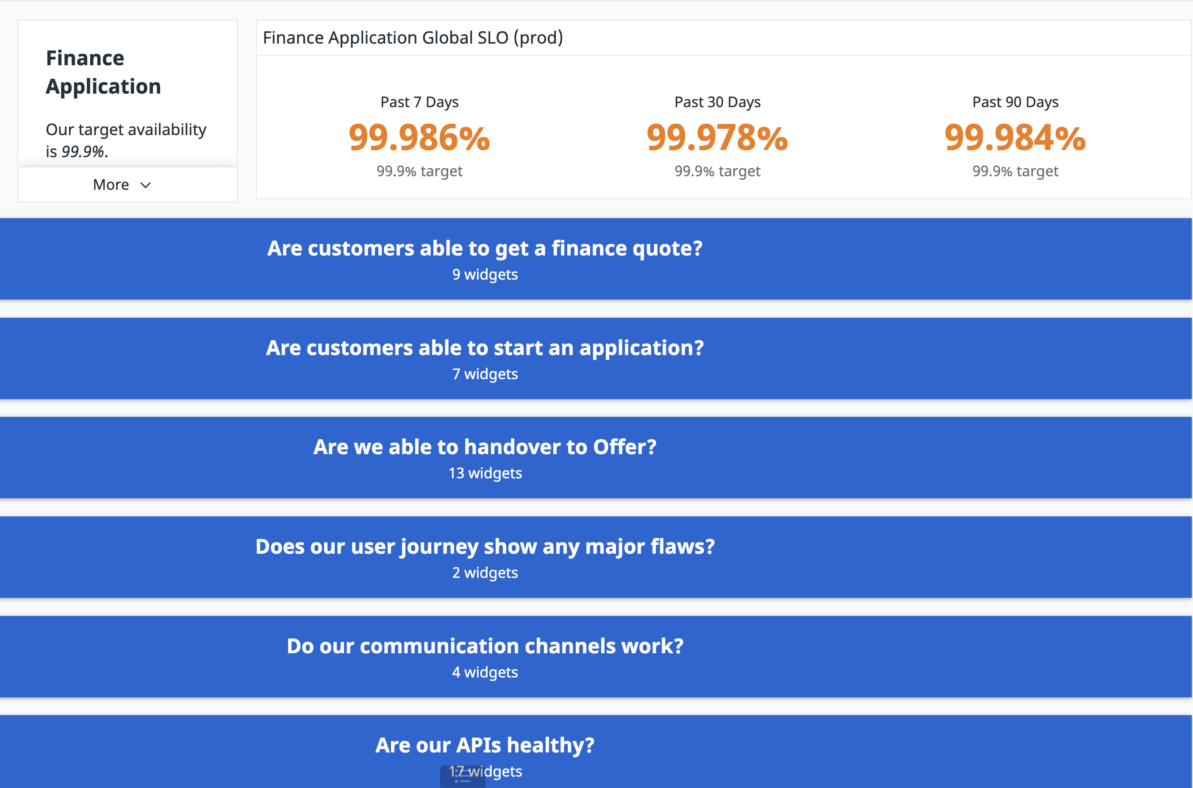

Contract testing
Documenting events
Observability
practices
Notes:
We started modelling

Slide 108
What did this mean for teams?

Slide 109
A few weeks later
Inventory
Search
Shared event bus
Inventory
Vehicle Detail
Search
Shared event bus
Shared event bus

Slide 110
✅ Can focus on inventory
Inventory
Vehicle Detail
Search
Shared event bus
Shared event bus
❌ Gets a new
consumer

Slide 111
✅ Has control of its own data
Inventory
Vehicle Detail
Search
Shared event bus
Shared event bus
❌ Accepts complexity in favour of consumers

Slide 112
✅ Conversations, events reduced to one
Inventory
Vehicle Detail
Search
Shared event bus
Shared event bus
❌ Relies heavily on Vehicle Detail

Slide 113
🚗 Inventory could focus on the car and its status
💿 Vehicle Detail had ownership of its own car detail
💜 Search could focus on making search awesome
Notes:
What's good: Product Detail and Search more aligned - had similar needs!
example: AOS detail, it is added to the event, search could extend their capability

Slide 114
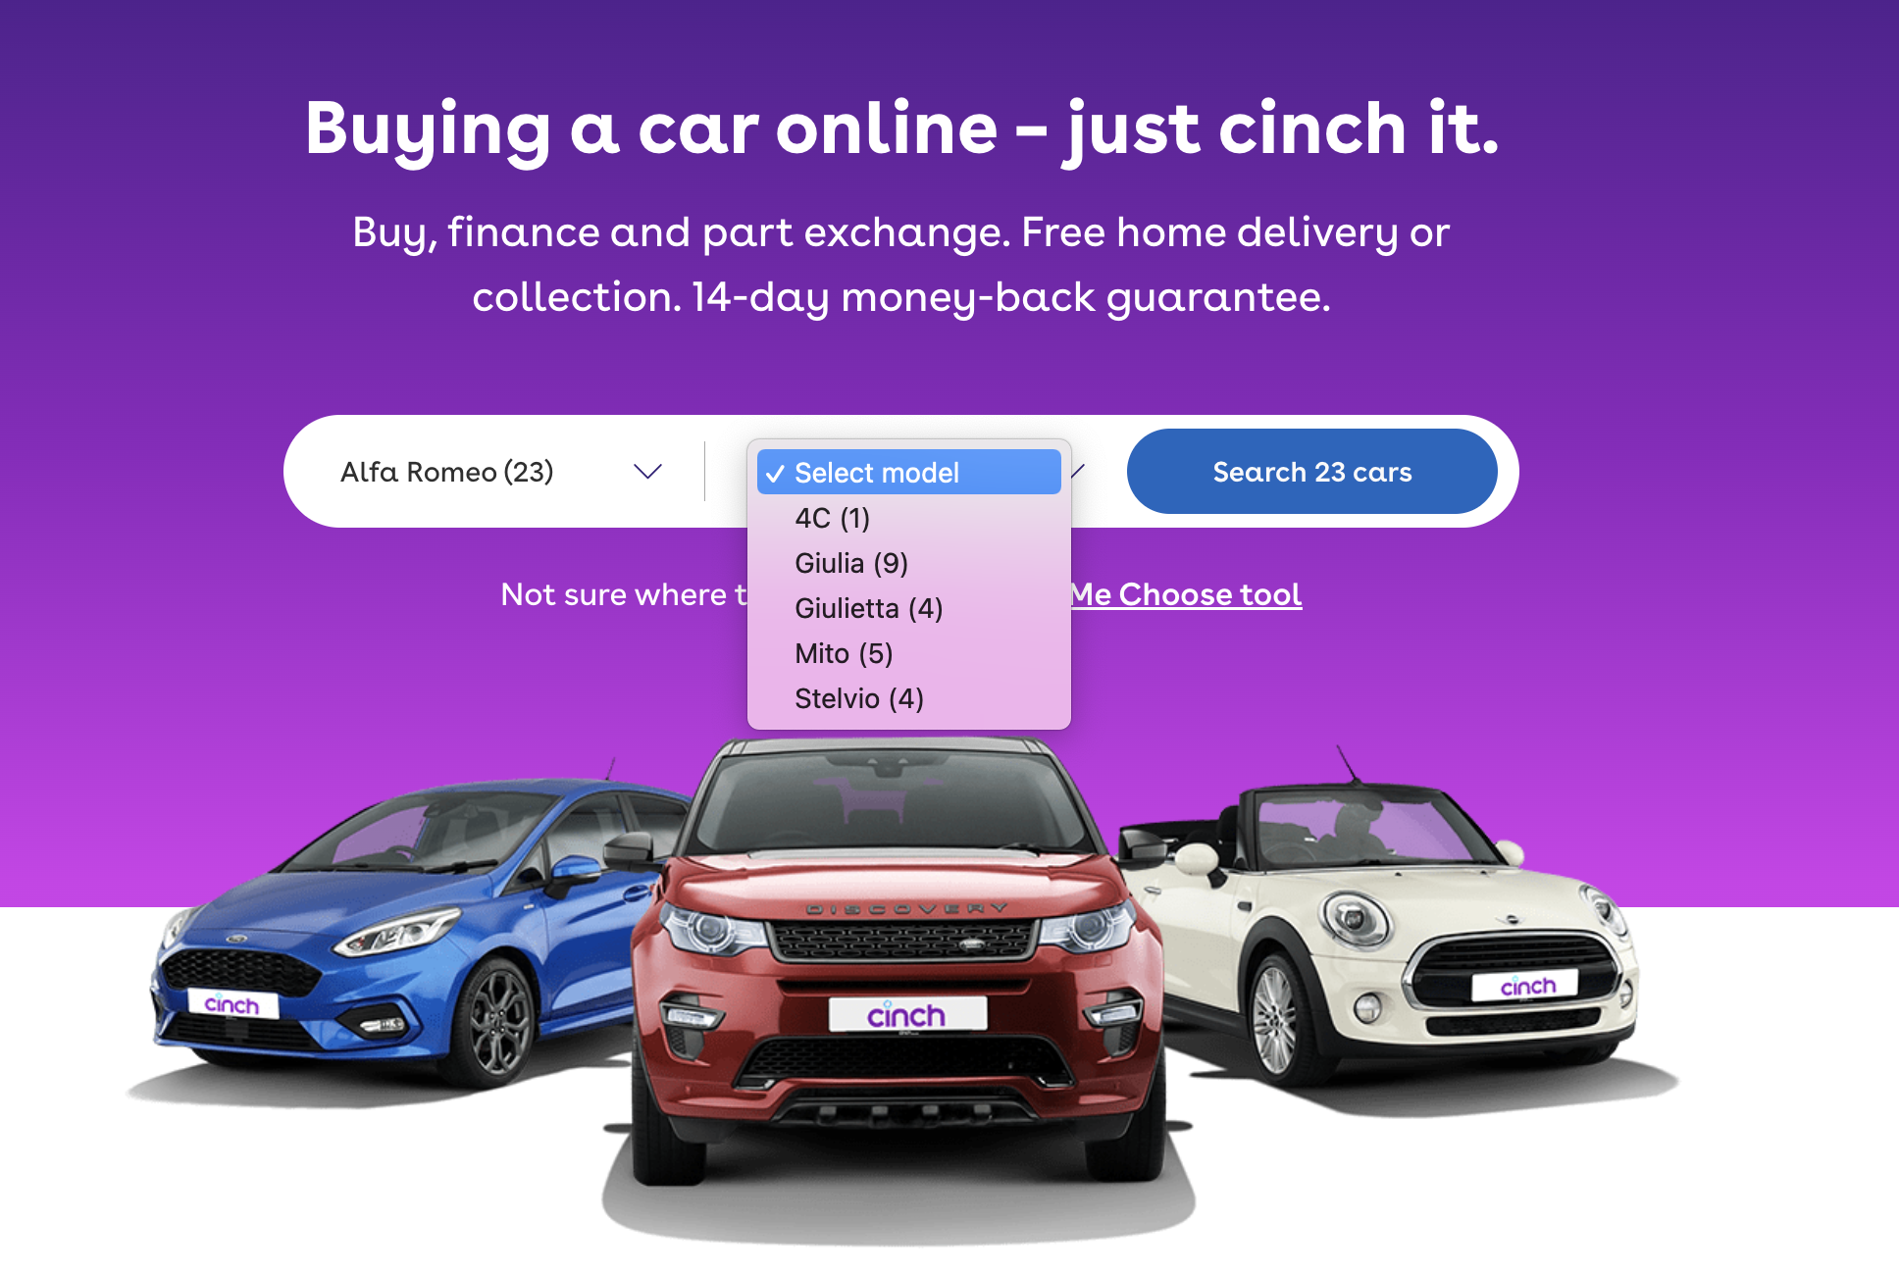
Search were able to make filters awesome

Slide 115
Search
Search Component
2
Sort & Filter
cars
API Gateway /vehicles
3
Fetch
snapshot on cache expiry
1
User searches cars

Slide 116

Search
Search Component
2
Sort & Filter
cars
❌
API Gateway /vehicles
3
Fetch
data from
Amazon OpenSearch
1
User searches cars

Slide 117
Conclusion

Slide 118
🏃‍♂️ We chose serverless EDA and ran with it
💪 We evolved our systems with little friction
🏎 EDA (+ serverless) enabled teams to be autonomous and move at pace

Slide 119
🤗 We built an eventually consistent decoupled system to protect our customers
💜 Domain events are our protagonists
✍️ We only need an interface contract
Notes:
The good bits!

Slide 120
Scale without having to manage much
Serverless Event Driven systems…
Are quicker the more it gets used
Cost less than containerized solutions
Notes:
How did it perform?

Slide 121
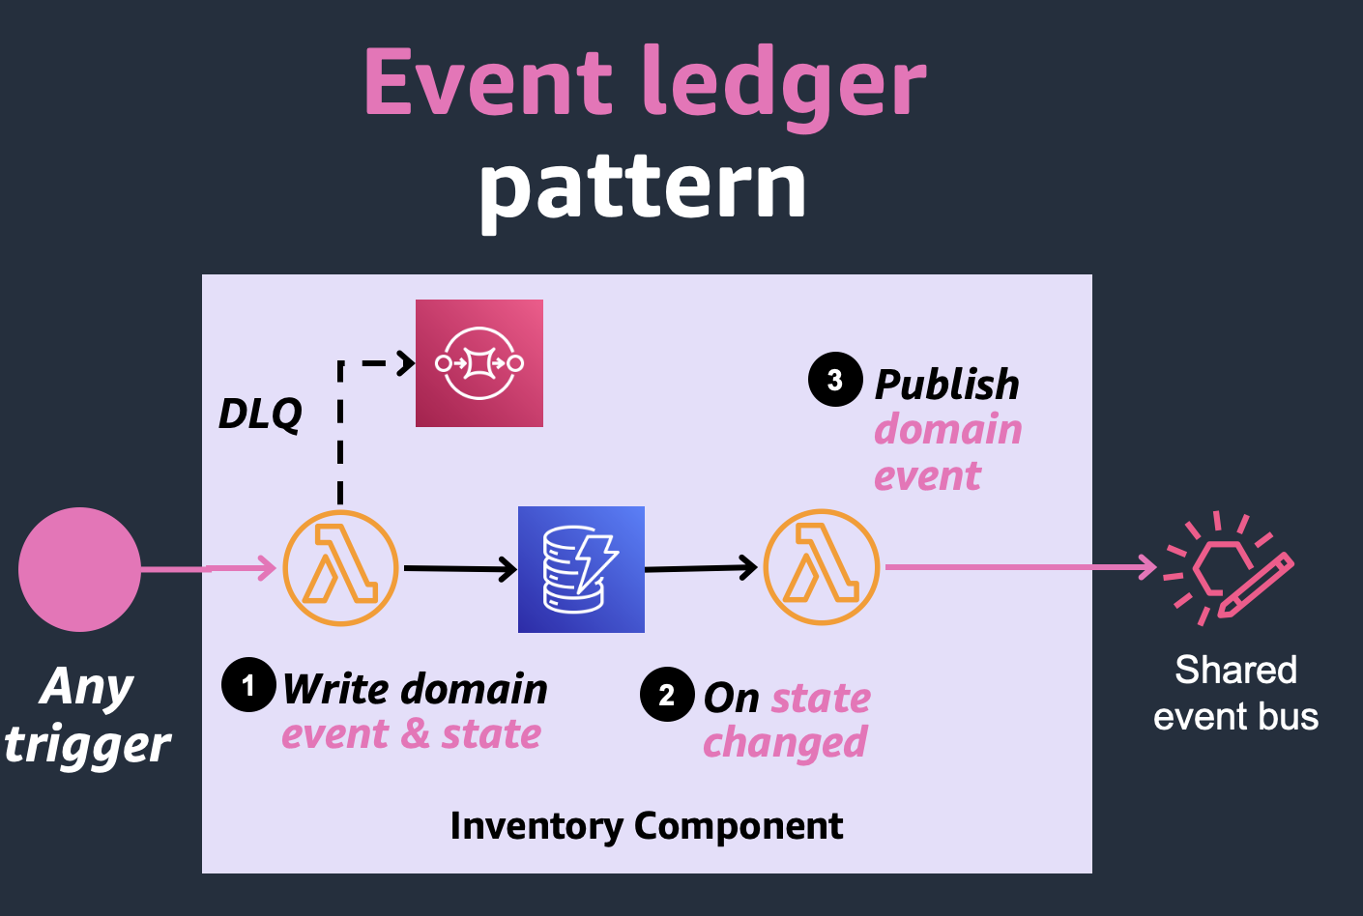
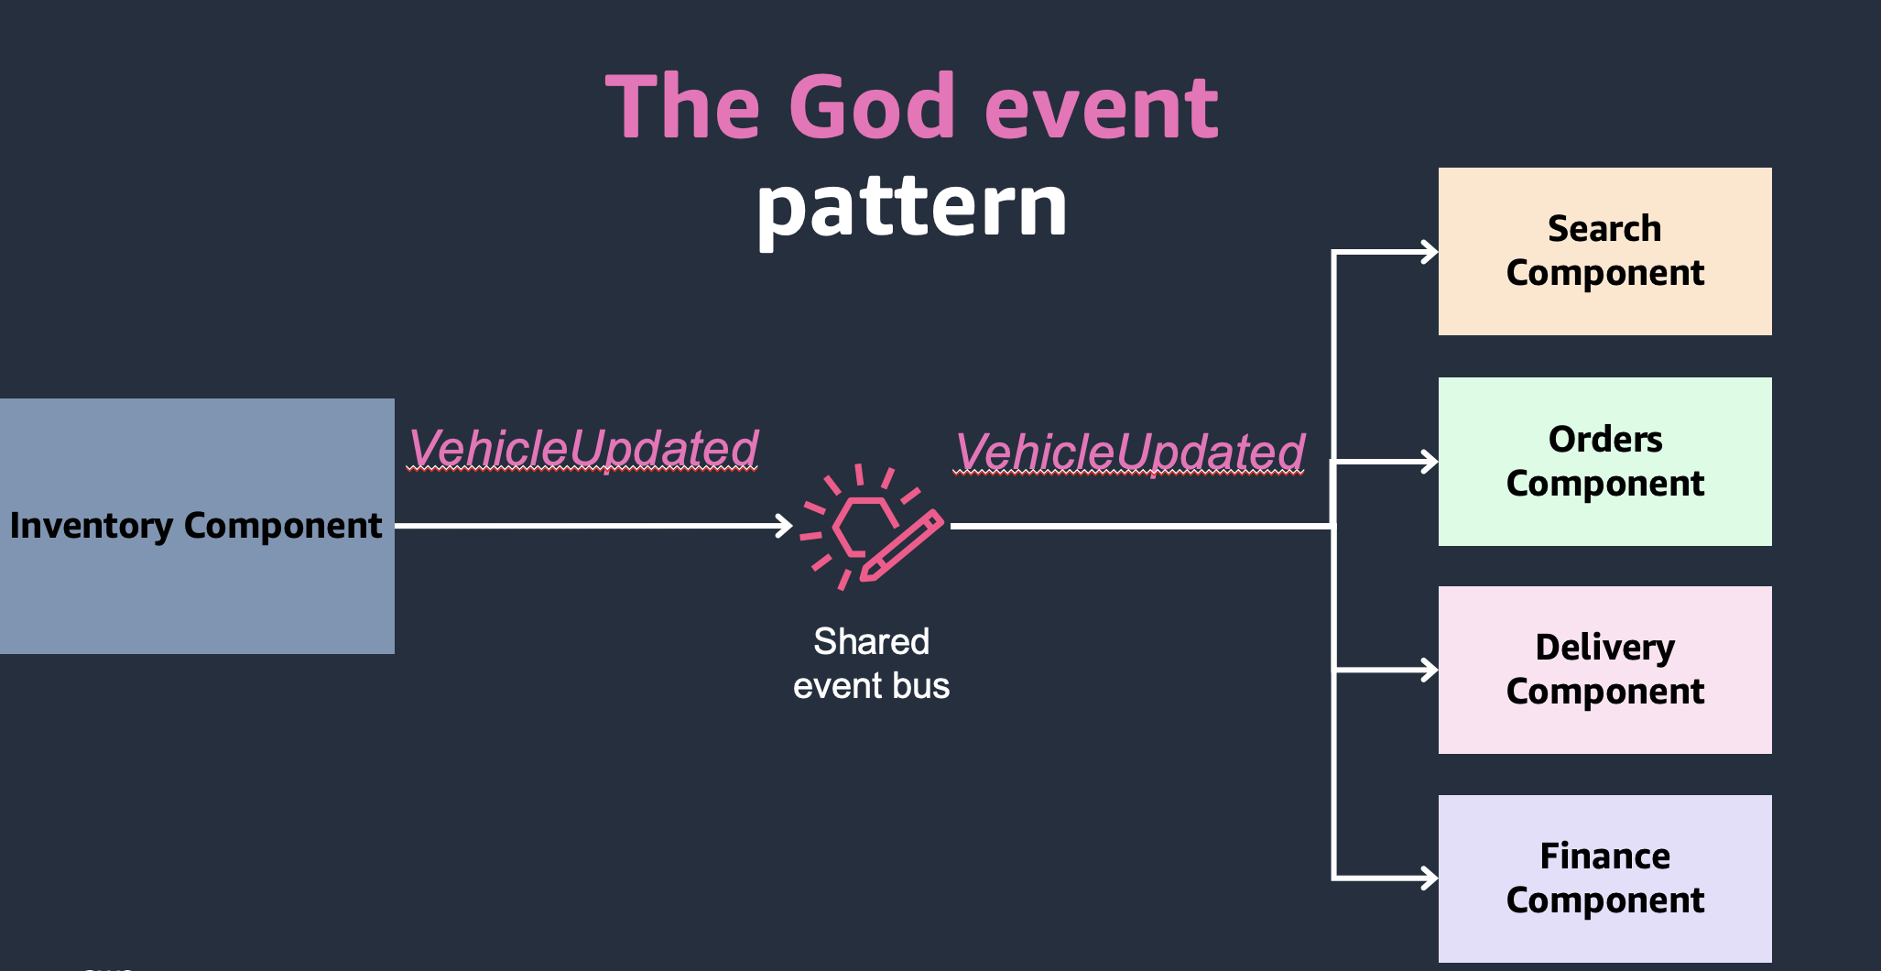
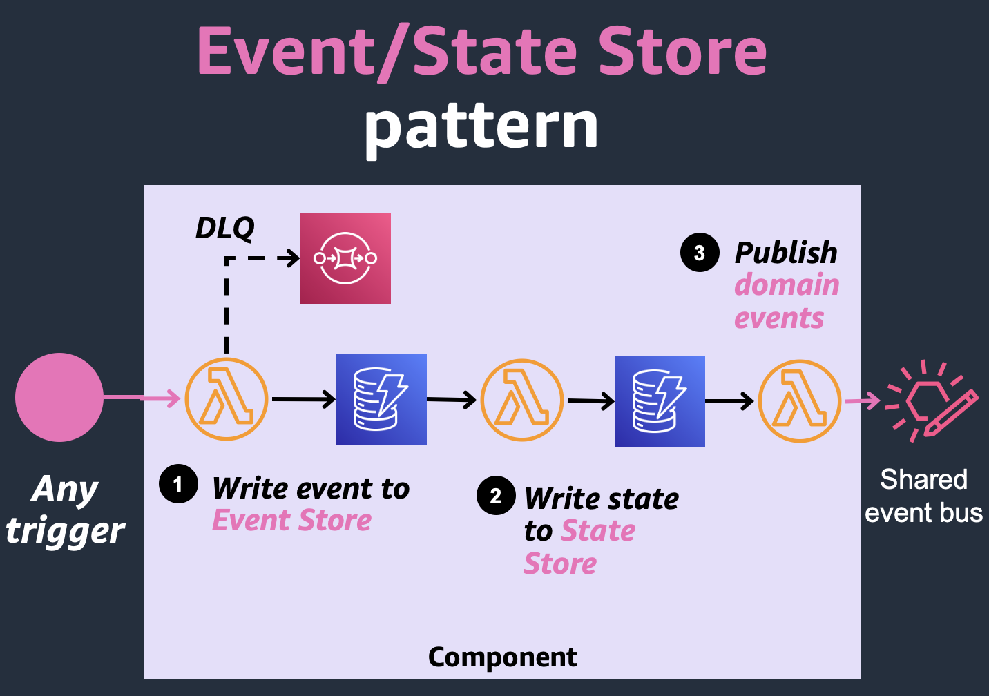
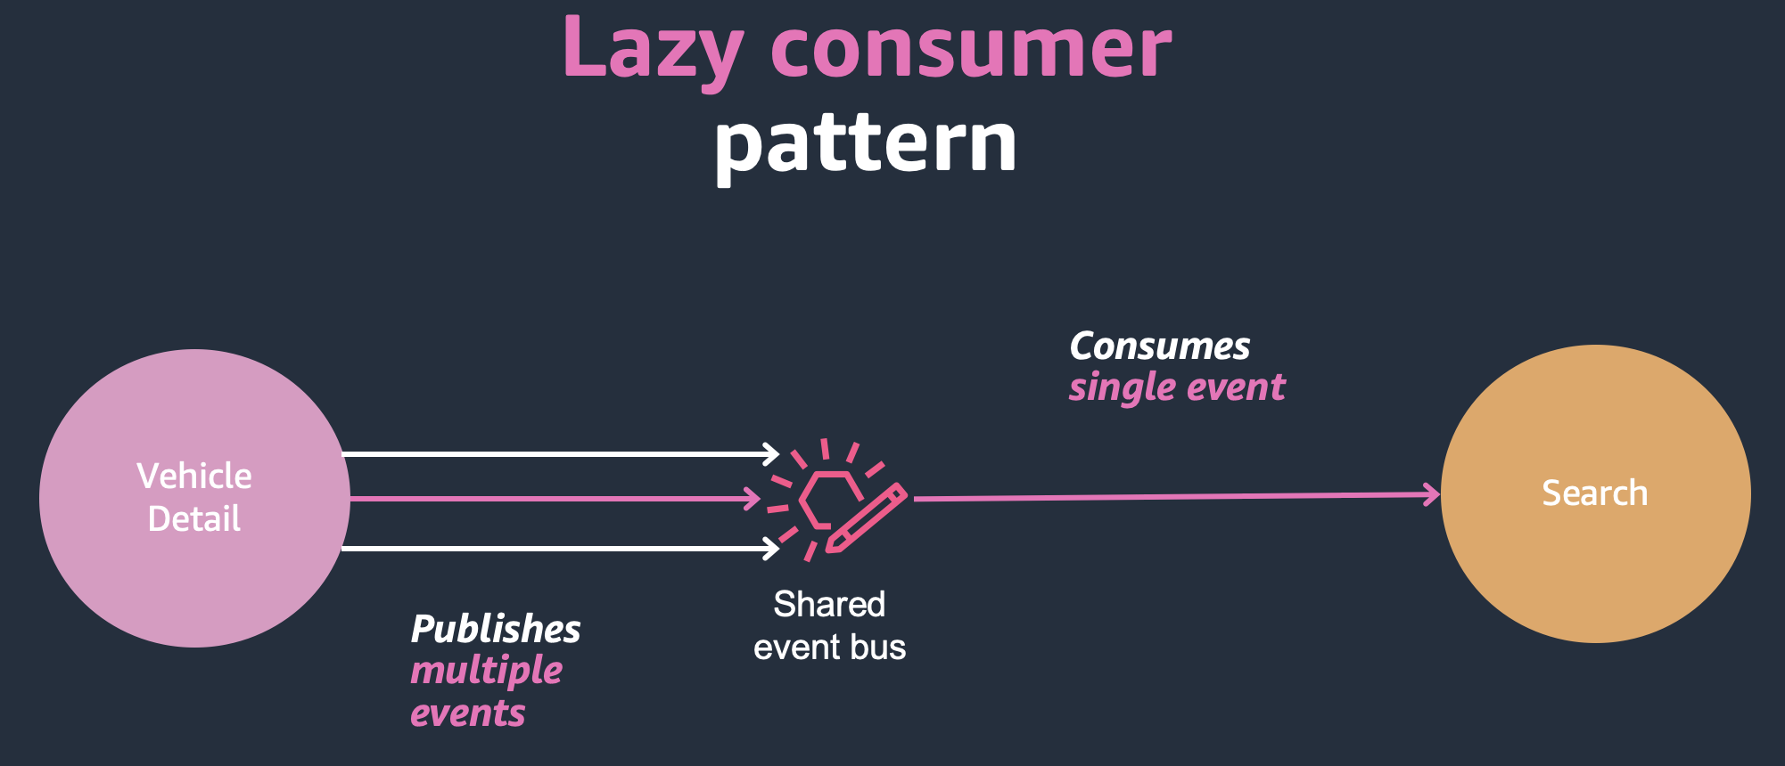

Slide 122
Event/State Store pattern
Event ledger pattern
The God event
pattern
Separate stores
Lazy Consumer pattern

Slide 123
Event/State Store pattern
Event ledger pattern
The God event
pattern
Separate stores
Smaller events
Lazy Consumer pattern

Slide 124
Event/State Store pattern
Event ledger pattern
The God event
pattern
Separate stores
Smaller events
Lazy Consumer pattern
Use DynamoDB change streams

Slide 125
Event/State Store pattern
Event ledger pattern
The God event
pattern
Separate stores
Smaller events
Lazy Consumer pattern
Use DynamoDB change streams
Be intentional with tradeoffs

Slide 126
Events are simple, declarative
Events are a data transfer mechanism
👍
System is extensible
Teams like it

Slide 127
It doesn’t matter.

Slide 128
Event-Driven, Serverless systems allow you to experiment and evolve.

Slide 129
You can make mistakes and recover from them.

Slide 130
Think in events, be deliberate about their design.

Slide 131
Throw it away and start again.

Slide 132
Thank you!

Slide 133



Let us help you
Ask questions
through the app
remember to rate the session
THANK YOU

Slide 134
Remember to
rate the session
THANK YOU

